Slide 1
SEPTEMBER 10, 2025 | KRAKOW, PL

Slide 2
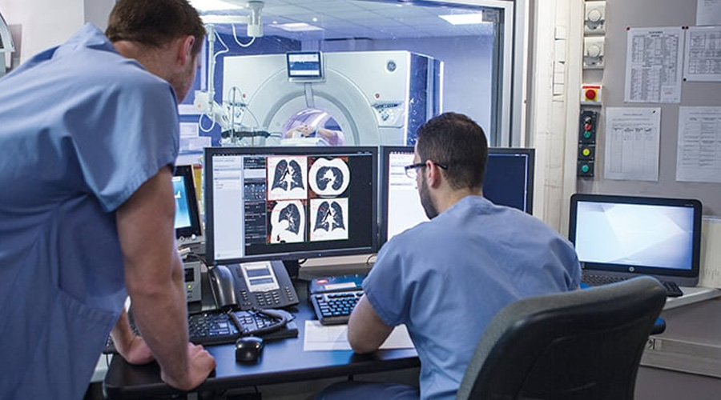
AI-driven diagnostic systems achieve higher accuracy in detecting diseases such as cancer, cardiovascular conditions, and neurological disorders through advanced image recognition and pattern analysis.

Slide 3
Predictive analytics powered by AI enables the development of personalized treatment plans by integrating genomic data, patient history, and real-time monitoring.

Slide 4
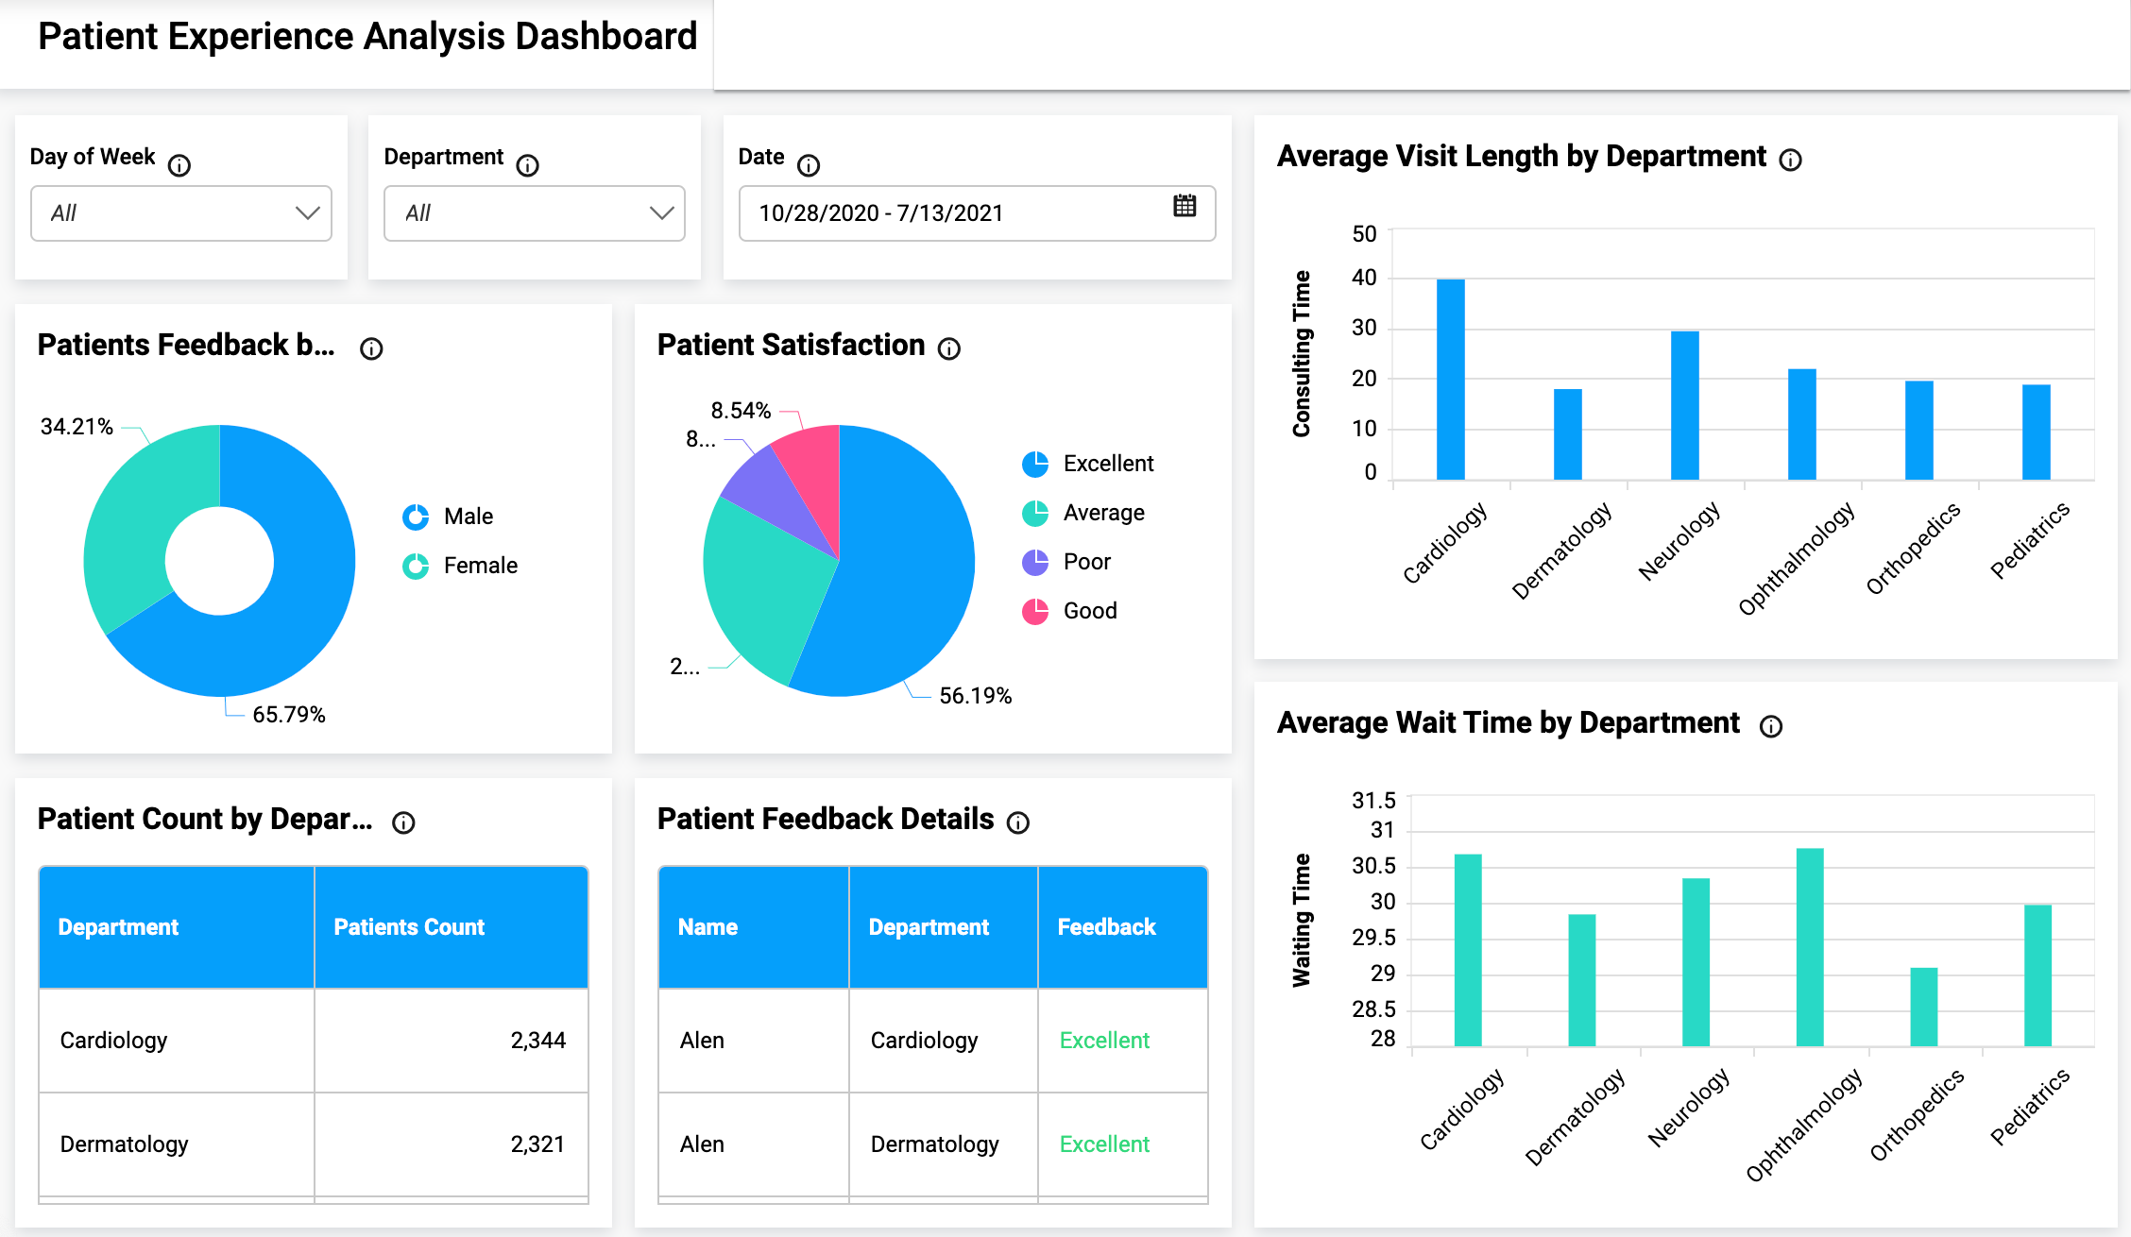

Slide 5
AI-enabled process automation optimizes hospital workflows, reduces diagnostic delays, and improves patient outcomes while lowering operational costs.

Slide 6
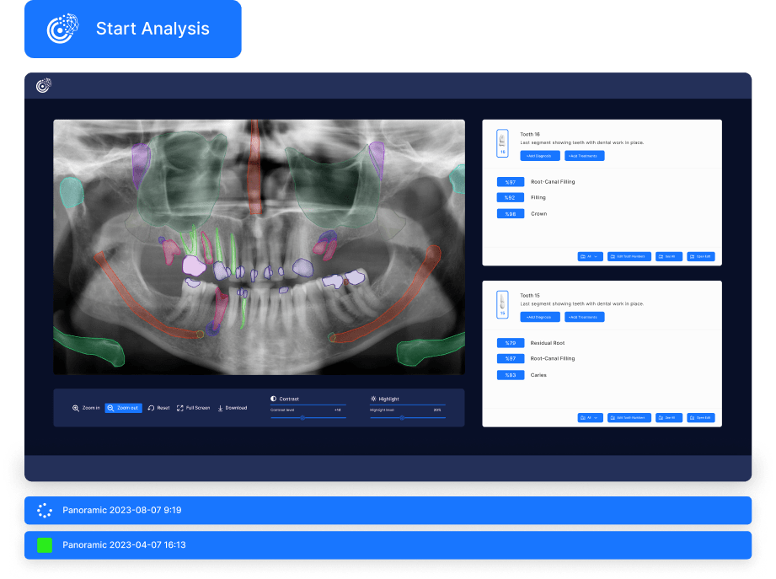

Slide 7
SEPTEMBER 10, 2025 | KRAKOW, PL

Slide 8
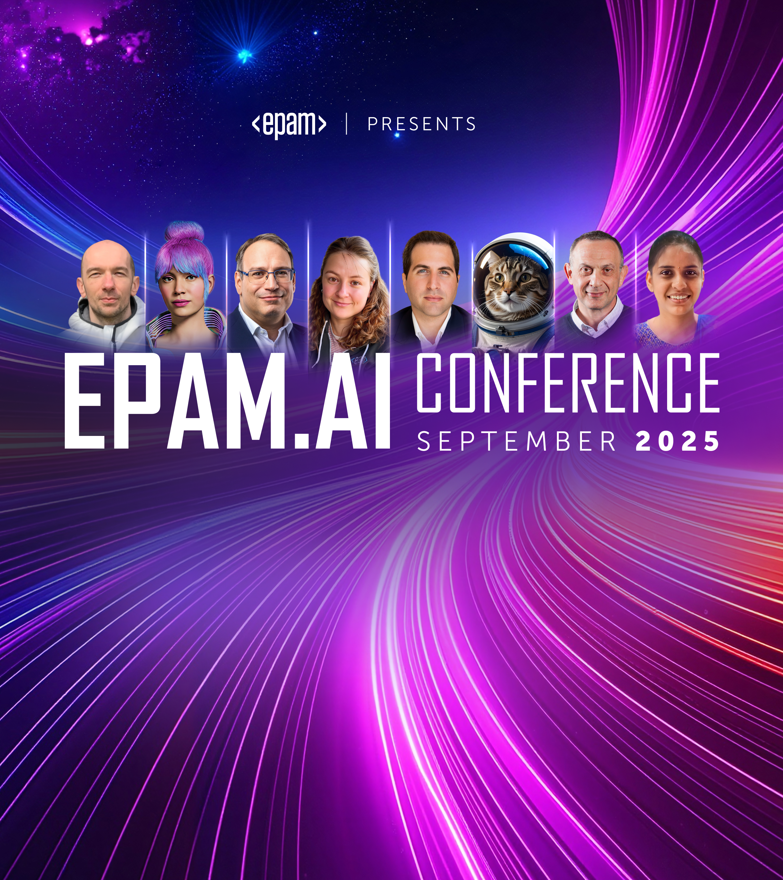
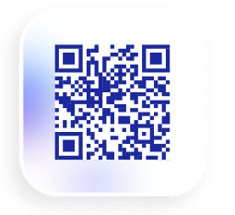
Join EPAM.AI Conference
Join us in September for a multi-day event where we will explore how Al will transform the future of our jobs and roles.
Learn from hands-on Al experts through talks, workshops and networking.
Got questions? Contact the conference team at OrgAIUpdates@epam.com
https://epa.ms/ai-conference-2025

Slide 9

EPAM.AI Conference
EPAM.AI Conference is a global event created by people for people that helps understand how AI is changing the ways we work through talks, workshops, discussions, and networking.
By joining, participants will gain helpful knowledge, practical skills, and confidence to succeed in an AI-powered world.
Conference timeline: September 18 – October 3
Conference format: city-level, country-level and global events
Got questions? Contact the conference team at OrgAIUpdates@epam.com

Slide 10
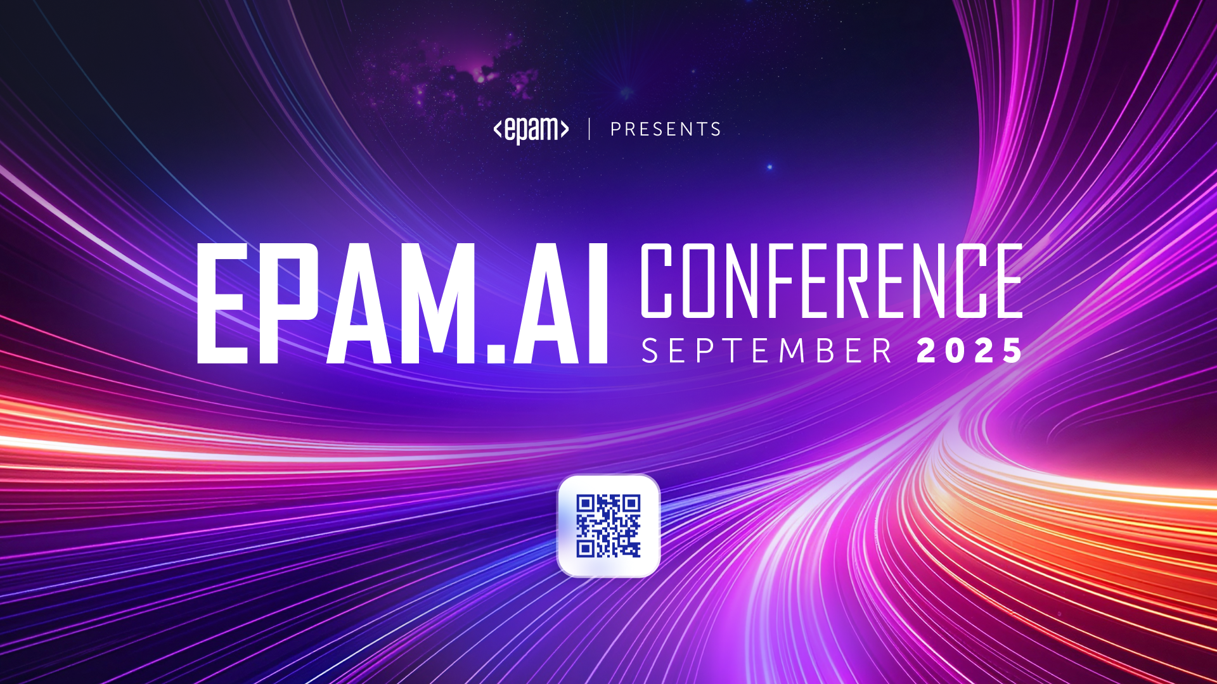

Slide 11
SEPTEMBER 10, 2025 | Asia East & Pacific

Slide 36
dddd

